Slide 2
Connecting every trip, every traveler and every bit of data.
Concur TripLink:

Slide 3

Your managed travel program is working well.
Notes:
As you can imagine, we talk to hundreds of clients every day about their travel and expense programs. We hear what’s working well for them, and we also hear about the challenges they face.
We talk to great companies with great programs like the one you’ve built. We see companies who’ve taken control of their travel budget, and have:
- Effectively centralized spend through a single process and system
Created amazing efficiency by streamlining and automating the process
- Negotiated tremendous discounts that are driving real savings
Your program is among the best of them, with an amazing X% spend under control.

Slide 4
But unmanaged travel continues to create challenges.
Notes:
But, even with X% travel under management, there is still X% of travel you’re blind to. For most managed travel programs, the issue of UN-managed travel continues to create challenges.
No matter how strong a program, how refined a system, how powerful a policy you put in place, industry data suggests you’ll continue to see unmanaged travel in 40-80% of your bookings.

Slide 5
It happens for a reason.
And this trend is only increasing.
“I’m two nights away from earning status”
“I just call my platinum number or use the Delta app, and my booking is completed immediately.”
“I’m saving my company money! I just scored a great deal on Hotwire for the same hotel I was planning to stay at anyway.”
“I don’t have time to mess around with calling the travel agent and my company doesn’t want me wasting my time on that either.”
“I’m attending a conference that has a group rate at the conference hotel”
Notes:
Now this isn’t a new problem. It has been happening for years, and a lot of the time, it’s for very good reasons: conferences, getting client rates, etc.
But no matter why it’s happening, it’s still creating challenges. And we all need to acknowledge that it’s only going to increase.
Suppliers, for example, are going directly to travelers, and they can’t be stopped. Travel suppliers are bypassing the corporate travel mechanism and going directly to business travelers. And if you or I were in their shoes, we’d do the same thing.
Suppliers know they can influence corporate spend if they communicate with travelers directly.
Suppliers want travelers’ leisure travel dollars too—not just their corporate spend.
Suppliers now have the media and methods to reach travelers directly.
There’s no reason to believe this trend is going to do anything but increase over time.

Slide 6
Unmanaged travel erodes your data.
You can’t see spend until it’s too late.
Inability to keep tabs on travelers and keep them safe on the road.
Inconsistent, difficult experience for your travelers.
Notes:
The trouble with unmanaged travel is that it erodes your data, and that affects so many other core issues. When you lose the data from these bookings, you :
Can’t see spend until it’s too late. You can’t manage your budget accurately because you don’t know your travel costs until an expense report is filed 4 months after a trip. Make sure your travelers aren’t planning to stay at the four seasons before the trip occurs
You lose the ability to keep tabs on travelers and keep them safe., because you don’t know where they are
You can’t deliver a consistent, easier experience for your travelers.

Slide 7
You trust your employees to make smart travel choices
Notes:
As you can imagine, we talk to hundreds of clients every day about their travel and expense programs. We hear what’s working well for them, and we also hear about the challenges they face.
We talk to great companies with great programs like the one you’ve built. We see companies who empower their travelers to make great decisions for their company and who have programs that work extremely well. Truth be told, at Concur, we see companies like yours as the visionaries. We believe the model you’ve embraced will become the future, and you’re ahead of the trend.
You’re empowering employees to make smart, money saving choices
You’re not bogging down travelers with all sorts of rules and processes – hoops to jump through before booking a trip

Slide 8
Traveler flexibility is great! But booking outside a system can create challenges
Notes:
For most managed travel programs, the issue of UN-managed travel continues to create challenges.
No matter how strong a program, how refined a system, how powerful a policy you put in place, industry data suggests you’ll continue to see unmanaged travel in 40-80% of your bookings.

Slide 9
Unmanaged travel creates blind spots.
Complicated expense reporting process
Inability to locate travelers and keep them safe on the road.
Missed savings opportunities
Notes:
The trouble with unmanaged travel is that it erodes your data, and that affects so many other core issues. When you lose the data from these bookings, you :
Your accountants and managers san’t see spend until it’s too late. You can’t manage your budget accurately because you don’t know your travel costs until an expense report is filed – sometimes up to 4 months after a trip. Also, expense reports take longer for your travelers to complete because they need to enter every line item from hotel, airline and car rental receipts. The process isn’t connected for the travelers so the data needs to be re-entered at every turn so they can get reimbursed.
You lose the ability to keep tabs on travelers and keep them safe., because you don’t know where they are
When you don’t keep track of where your travelers spend their money, you’re much less able to negotiate rates with the vendors your travelers choose to use. This is especially true if you don’t have high corporate card adoption.

Slide 10
The problem isn’t that your travelers are booking OUTSIDE the system.
The problem is data can only be tracked when travel is booked INSIDE the system.
Notes:
The Problem isn’t that your travelers aren’t booking through the system – 80% of the time they are. But 80% of the data isn’t good enough. And, that number isn’t going down – trends show that it’s only going to increase. So stop throwing all of your energy into trying to achieve an extra ½ % increase in compliance while fighting an uphill battle the whole time. Focus on the real problem
The Problem is that you’re not able to see their data unless they book through the system – lets focus on identifying the issues that result from lost data and figure out how to get the data you need to make those problems go away

Slide 11
What could YOU save?
Notes:
Industry data suggests 40% of hotel reservations are made outside of corporate booking tools.
This means that you’re missing out on 40% of your negotiation power
Your TMC data shows that you spend ($500,000) at the (Enter hotel name here)
Because we know that you’re actually missing ~40% of your spend in your TMC, you’re actually probably spending more like ($700,000)
Do you think that extra $200,000 could earn you a better rate?
How much better? 1%,2% better? 3% better?
On average you pay $180 a night. Now lets say you’re able to save 3% more reducing that to $174 doesn’t seem like much, but it’s actually $27,500 in savings over the course of the year.
THAT’S ONLY 1 HOTEL – NOT EVEN YOUR MOST FREQUENTLY USED HOTEL! NOW MULTIPLY THOSE SAVINGS ACROSS 500 HOTELS! We’re talking about real savings – multiple hundreds of thousands of dollars.
Now although only ~10% of hotel spend occurs outside of the managed travel program, but as we just saw, capturing that data can result in savings you’ve never ever been able to capture before because you’re not looking at all of your travel spend.

Slide 12

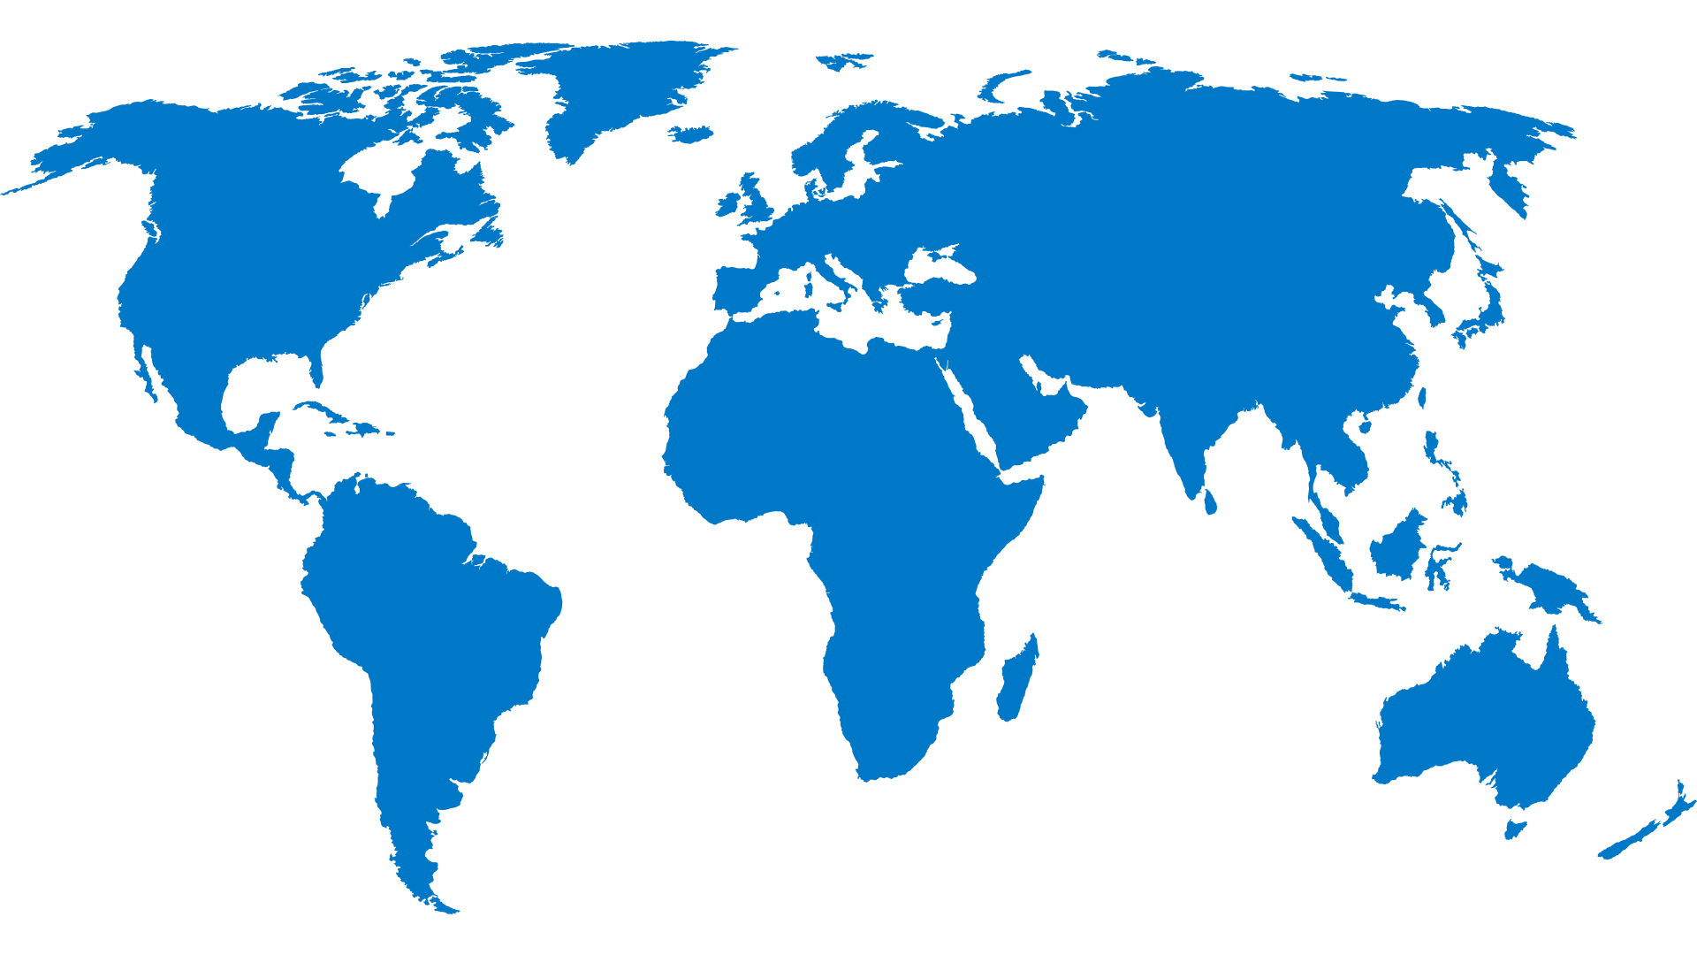


See all your people, so you can support them all.
Notes:
There’s safety (and security) in all that new data you’ll now have.
And cost is only one issue. If you don’t know where your people are, how can you support them? Even if you have the vast majority of itinerary data in your system, all it takes is a few unaccounted for travelers to cause significant services issues if they need help or significant security and liability issues, if emergencies arise.

Slide 13


You have a right to know where your money is being spent
Notes:
So how do you address this issue? How do you focus on getting the data, instead of trying to force travelers to always use a tool you know they aren’t going to always use?
Embrace your travelers and get all of the data you need by bringing travel itineraries & reservations booked outside of your managed travel program into your managed program
*You have a right to know where your money is being spent. If they’re going outside of the managed program, you’re losing that right. How do you correct it? How do you improve it?

Slide 14

Concur TripLink
Booking Tool
Travel Agent
Supplier
.com
TripLink
Notes:
TripLink is a new core service from Concur that integrates itinerary information into the Concur system, no matter where its booked.
This provides travelers with the benefits of fully integrated expense reports, regardless of where trips are booked…while providing corporations with all of the benefits of Integrated Travel & Expense.
Put simply…
TripLinklets business travelers book hotels and rental cars outside of Concur Travel while, at the same time, capturing and providing all travel transaction data to Travel Managers through Concur Travel & Expense.
Corporations maintain the benefits of a managed program…
and get the insight into spend and visibility to where travelers are…
fulfilling their duty of care responsibilities.

Slide 15
The future: Direct connections.
Supplier
.com
TripLink
Integrations with select suppliers send itinerary information directly to Concur.
No email forwarding required.

Slide 16
Get the data and reap the rewards.
Better visibility
Insight on all traveler
spending/buying behavior.
More control
Enforce your policies and complete audits on all transactions.
Stronger negotiations
Get every discount
you deserve.
Notes:
With all that information integrated with the rest of your managed travel data, you can get:
Better visibility: Get the complete picture, detailed reporting and insight on all your travelers’ spending trends and buying behavior.
More control: With TripLink, you can enforce your policies and complete audits on all your transactions, no matter where they’re booked.
Stronger negotiations: TripLink provides a complete view of all your transactions, so you can negotiate more effectively with vendors and get every discount you deserve.

Slide 17


With all that data, you can do great things.
Notes:
TripLink also includes two additional tools to help you address the leakage issue and get your hands on more data.
Price-to-Beat and TripPoints
TripIt Pro

Slide 18
Improve their experience, and they’ll be more productive.
1
One itinerary
in one place.
Manage and access a single, simple, electronic itinerary from anywhere on any device
Integrated simple user experience.
With travel pre-populated, completing expense reports is a breeze
Help that’s one
click away.
Get click-to-assist even when booked outside of your TMC.
Notes:
One itinerary in one place.
With TripLink, your travelers get a single, simple, electronic itinerary that combines reservations booked both inside and outside your travel program, so they’ve got their whole trip in one place. Right there on their tablet, laptop or smartphone.
Manage the trip on the go.
With all your travelers data safely secured in your Concur system, they’ll be able to manage their air, hotel and car reservations on the go with Concur’s mobile app.
Help is one click away.
With all that information in one place, travelers can use the click-to-assist functionality within Concur mobile to get assistance, if they need it, from your TMC—even if they booked their reservation on their own.

Slide 19
Use TripIt to make travel more effective.
TripIt Pro
Get flight alerts.
Find better seats.
Track rewards points.
Find alternate flights.
TripIt for Teams
Centralized calendar to track all travel.
Spot savings by eliminating redundant trips.
Notes:
When your travelers don’t use your tools, you don’t get the data. And, ultimately, control. TripLink also includes TripIt Pro—a world-class travel tool that millions of travelers from non-Concur customers choose to use and pay for on their own. And once they experience TripIt Pro, your travelers won’t just want to use it, they won’t leave home without it.
With TripIt Pro, travelers can:
Share their travels within their social circles
Get flight alerts
Find better seats
Track their rewards points
Find alternate flights if their plans change
With TripIt for Teams, your teams can:
Centralized calendar to track all travel
Spot savings by eliminating redundant trips

Slide 20
Price-to-Beat:
Create a culture of savings.
Set target prices for flights and hotels.
Improve travelers’ budget awareness.
See how your spend stacks up.
Notes:
What’s Price-to-Beat?
It’s a game-like solution inside of Concur that:
1) Lets you name the price you want your travelers beat—with airlines, with hotels, within specific markets and with specific brands, etc.—
2) And if travelers hit or beat that price, they get points.
3) And you can work with your clients to use those points in the right way for their culture. The right way for each client to put those points to work: financial incentives, leader boards, or simply pats on the back and other public peer recognition. Simply make the points work the way each client’s culture works, and you’ll drive engagement in policy
TripLink brings this solution to ALL your reservations, whether they’re booked inside our outside your system.

